Slide 1
Detection of cotton crop diseases
Final Year Project ON
Irsa Rafique
S22BSEEN1M01125
Presented by:
Supervisor:
Dr. Daler Ali Awan
Department of Software Engineering, IUB

Slide 2
Table Of Content
Introduction
Problem Statement
Scope
Working
System Architecture
Dataset
Model Training and evaluation
Integration of Mobile app and AI Model
Graphical User Interface
Future Work
Conclusion
Department of Software Engineering, IUB

Slide 3
Introduction
The "Detection of Cotton Crop Diseases" project aims to develop a mobile application using computer vision techniques to identify three major diseases affecting cotton crops: “Bacterial Blight, Curl Virus, and Fusarium Wilt”.
The project's primary goal is to assist cotton farmers in early disease detection, thereby preventing extensive crop damage and enhancing overall yield. The application run on the Android platform and employ advanced image processing and machine learning algorithms.

Slide 4
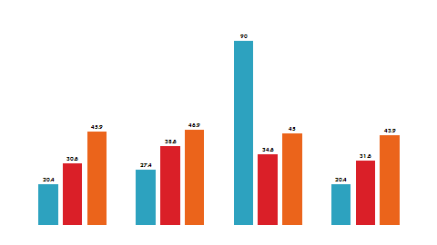
Problem Statement
  The cotton crop faces a constant threat from these three devastating diseases
Curl Virus:
First identified in 1911, Punjab region, Pakistan
Yield reductions of 80-100% are common in susceptible cotton varieties.
Estimated annual losses of $500 million globally.
Fusarium Wilt:
  First identified: Late 19th century in the United States.
  Yield losses of 20-50% are common, but complete plant death can occur
  Estimated annual losses of $1 billion globally.

Slide 5
Problem Statement
  a
Bacterial Blight:
  First identified in Early 20th century in the United States.
  Yield losses of 10-30% are common, but severe outbreaks can cause complete crop failure.
  Estimated annual losses of $1 billion globally.
Cotton accounts for over 10% of agricultural exports in Pakistan.
In 2015, curl virus alone caused an estimated loss of $1.2 billion in export revenue in Pakistan.

Slide 6
Scope
  a
The project successfully addresses the critical need for timely disease detection in cotton crops, contributing to sustainable agriculture and food security. By leveraging computer vision, the application provides an efficient and user-friendly solution for farmers.
This project is not merely an academic exercise; it's a contribution to safeguarding Pakistan's cotton industry, a vital engine of the nation's economy. By empowering farmers with early and accurate disease detection, my app has the potential to:
Reduce yield losses
Improve cotton quality
Enhance farm profitability

Slide 7
Working of Project
  a
  The GUI of the project is a Android app, which could be operated simply.
  One can use it by simply clicking the photo of a cotton crop or by uploading the picture of a cotton crop leaf, then simply it will display up the name of the disease in three languages including, English, Urdu and Hindi.
Simple image capture: A user-friendly interface allows quick and easy capture of cotton plant images for analysis.
Real-time diagnosis: Results are displayed within seconds, empowering farmers to make informed decisions immediately.
Disease-specific information: The app provides readily available information about each disease, its symptoms, and recommended control measures.
Multi-language support: Cater to diverse user demographics by incorporating local languages, further enhancing accessibility.

Slide 8
System Architecture
  a
Efficient MobileNet Base: Chosen for its lightweight architecture and suitability for mobile deployment.
Image Augmentation: During training, various image transformations (rotation, zooming, etc.) were applied to artificially increase the dataset size and improve the model's robustness to variations in real-world images.
Strategic Freezing: Optimizes performance by reducing trainable parameters.
Custom Classifier: Tailored to the specific task of cotton leaf disease detection.
Dropout Regularization: Enhances generalization to unseen data.
TFLite Conversion: Enables seamless integration into mobile apps.

Slide 9
System Architecture
  a
1. Input Layer: Receives pre-processed RGB images of cotton leaves, resized to 200x200 pixels. Each pixel represented by 3 channels (Red, Green, Blue) for color information.
2. Pre-trained MobileNet (Base Network): Utilizes the pre-trained weights of MobileNet, a convolutional neural network (CNN) model trained on a massive image dataset (ImageNet). MobileNet extracts relevant features from the input images through a series of convolutional layers, pooling layers, and activation functions.
All MobileNet layers are frozen during training, meaning their weights remain unchanged, to:
  Reduce the number of trainable parameters and computational cost.
  Leverage the rich feature extraction capabilities of the pre-trained model.

Slide 10
System Architecture
  a
3. Custom Classifier:
Flatten Layer: Transforms the output of MobileNet in one-dimensional vector.
Dense Layer (256 neurons, ReLU activation): This initial layer maps the extracted features to a higher-dimensional space, allowing for more complex decision boundaries for disease classification.
Dropout Layer (0.5): Randomly drops out 50% of the neurons
Dense Layer (32 neurons, ReLU activation): Further refines the classification
Output Layer (4 neurons, Softmax activation): Employs a final dense layer with 4 neurons. The Softmax activation function normalizes the output to probabilities.
4. Output Layer: Provides a probability distribution across the 4 disease classes for each input image.
The class with the highest probability is predicted as the disease present in the image.

Slide 11
Dataset
  a
The dataset comprises of 4 classes, 1 healthy and 3 diseased classes.
The image data is in the form of JPEG files, while the leaves images and associated information are stored in a structured database.
The data is split into two sets: a training set and a validation set which is 80 and 20 percent accordingly
The training set is used to train the deep learning model, while the validation set is used to evaluate the performance of the model.
The dataset comprises of 1751 images, with 1400 images allocated for training the model.

Slide 12
Model Training and Evaluation
  a
During the model training phase, extensive experiments were conducted using the training dataset.
The model achieved an impressive
Training accuracy of 98.6%
Validation accuracy of 96.1%.
Training loss of 0.043%
Validation loss of 0.01%
Upon evaluation with the test dataset, the model demonstrated outstanding performance, delivering 100% accurate results in disease detection.

Slide 13
Integration of App and AI Model
  a
The AI model was converted to the TFLite format (Enables seamless integration into mobile apps.), enabling efficient deployment on mobile devices for on-field disease detection.
After converting into TFLite format H5 file was saved
That H5 file was integrated into the main class of the Android app which enhanced the functionality of the app as a AI based app, working offline

Slide 14
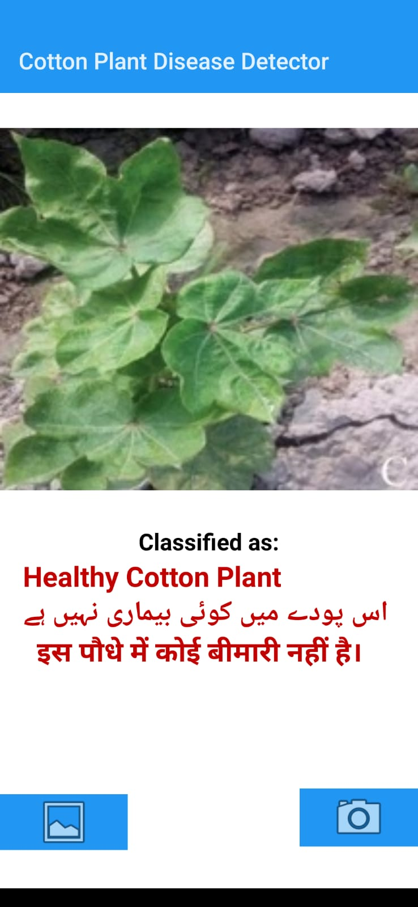
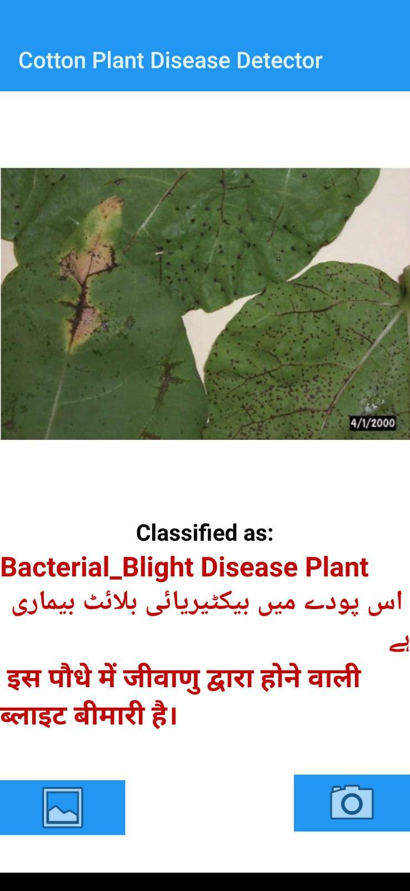
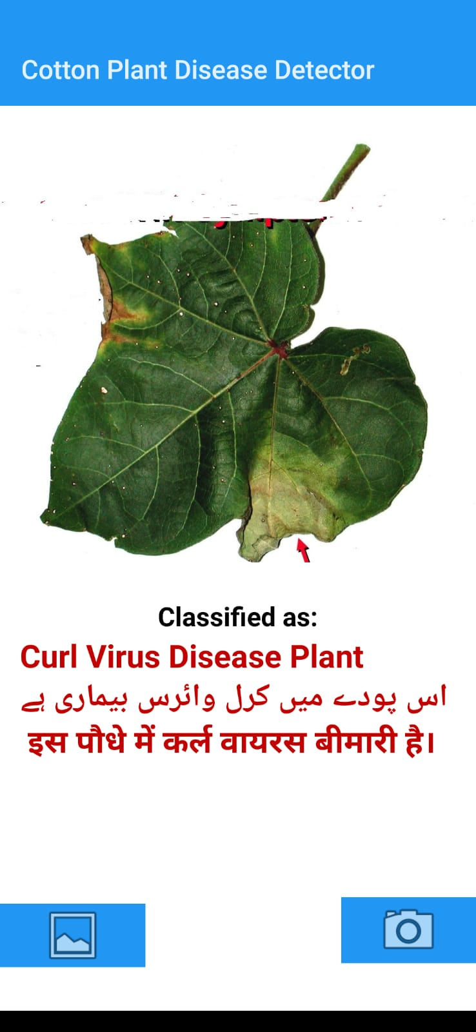
Graphical User Interface
  a

Slide 15
Future Work
The Cotton Leaf Disease Detection project lays the foundation for future enhancements and expansions. Some potential areas for future work include:
Multi-Crop Support
Suggestion of proper fertilizers for crop
Automated Alerting System
Localization and Adaptability
Collaboration with Agricultural Experts

Slide 16
Conclusion
In conclusion, the Cotton Leaf Disease Detection project has successfully implemented a robust and efficient system for identifying and analyzing diseases affecting cotton plants. Leveraging a deep learning model, the system can accurately detect three types of diseases by analyzing leaf images. The integration of a user-friendly interface and real-time monitoring capabilities enhances the usability and effectiveness of the application.
Disease Identification
Real-time Monitoring
Multilingual Support

Slide 17
Thanks
Department of Software Engineering, IUB

